Slide 1

Credit Card Churn Prediction
Predict which customers are likely to stop using their credit cards, enabling proactive retention efforts.
Submitted by: Mehakdeep Kaur
Trainer: Arun Kumar
github link:https://github.com/Mehak-deep-kaur/Credit-Card-Churn-Predic

Slide 2

Problem Statement
This project aims to predict customers likely to churn (cease credit card usage) based on behavioral and demographic data. The machine learning pipeline uses a Random Forest classifier, combined with careful data cleaning, feature engineering, and scaling.
Every churned customer represents lost transaction fees, interest income, and potential lifetime value.
20%
5x
70%
Average industry churn rate
Cost to acquire vs retain
Our model accuracy

Slide 3

Dataset Exploration
Features
CustomerID, Gender, Age
Tenure, Balance, NumOfProducts
HasCrCard, IsActiveMember
EstimatedSalary, Churn
Target Variable
Churn (0 = Stays, 1 = Leaves)
The model predicts this binary outcome

Slide 4


Data Cleaning & Preprocessing
Challenges Addressed
Inconsistent categorical data (case sensitivity, typos)
Missing values (imputed with median/mode)
Outliers (capped using IQR method)
Categorical encoding (one-hot)
Clean data is the foundation of accurate predictions. Our rigorous preprocessing ensures the model learns from quality information.

Slide 5
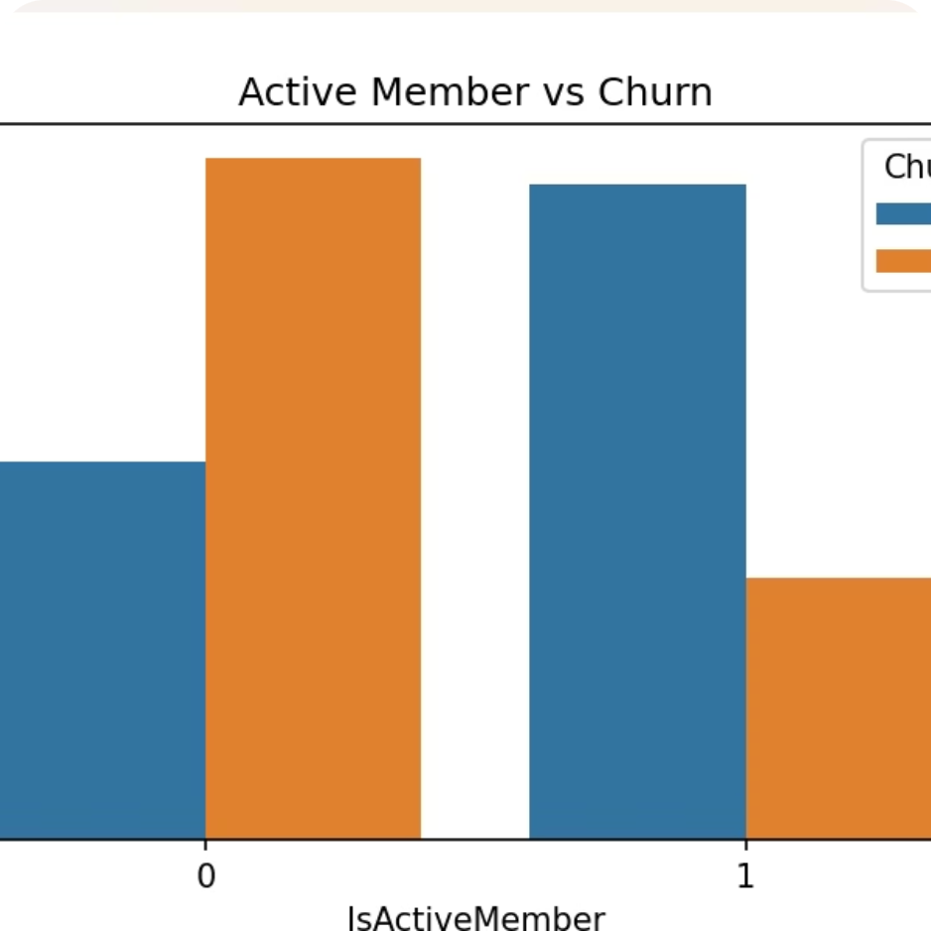
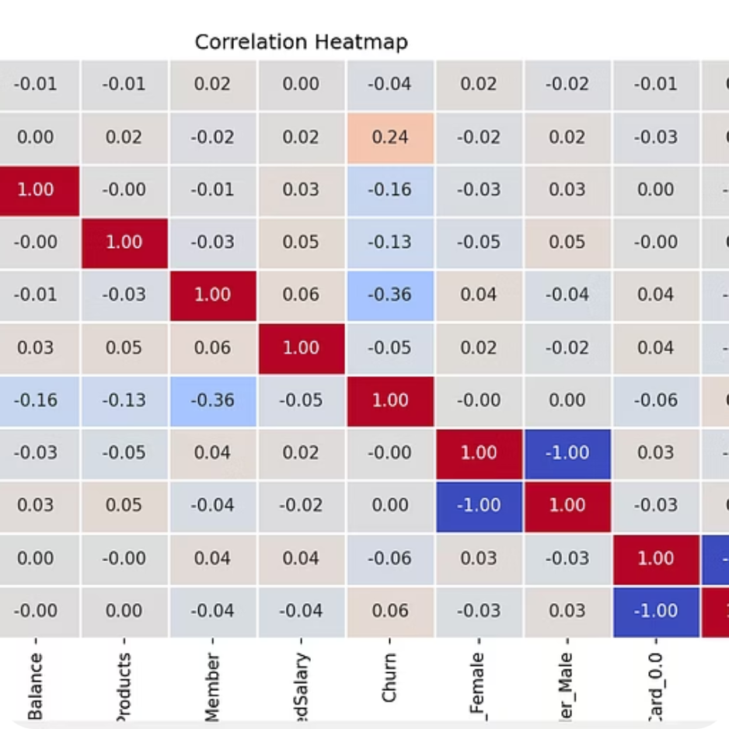
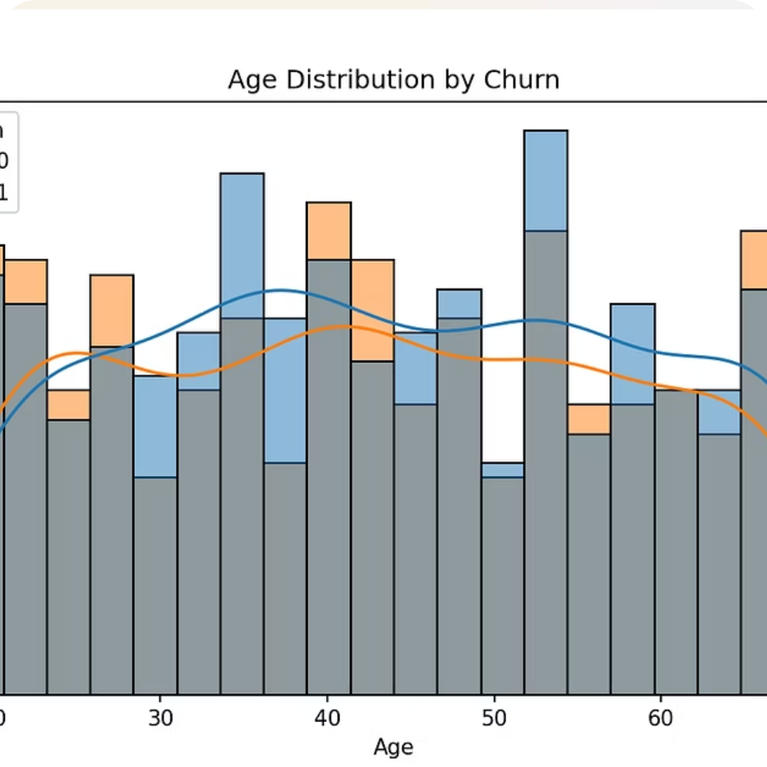
Exploratory Data Analysis
Age Distribution
Gender Analysis
Correlation Matrix
Analyzed customer age groups to identify demographic patterns
Examined churn patterns across different gender segments
Identified key factors influencing customer churn decisions

Slide 6



Feature Engineering Magic
Created New Insights
BalanceSalaryRatio = Balance / (EstimatedSalary + 1)
TenurePerProduct = Tenure / (NumOfProducts + 1)
IsHighValueCustomer flag (based on 75th percentile balance)
Applied Scaling
MinMaxScaler normalized numerical features to prevent bias from different scales
Final Feature Set
Combined scaled numbers, one-hot encoded variables, and engineered features

Slide 7
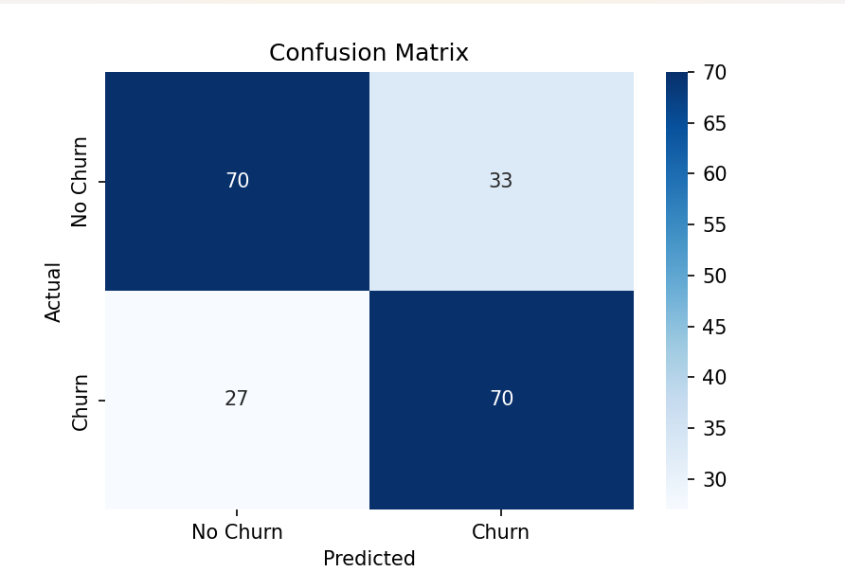
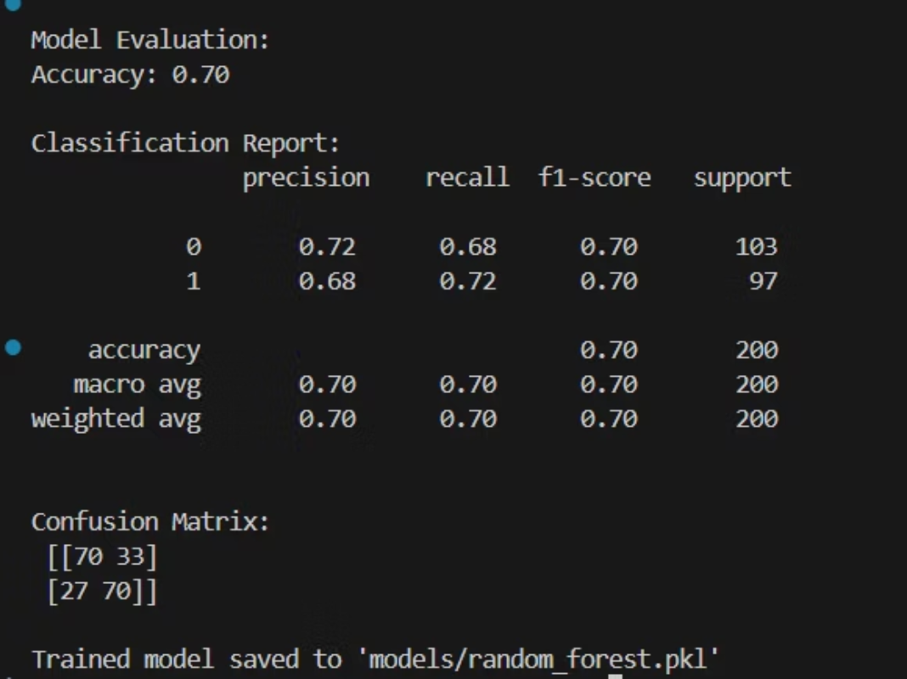
Model Training & Results
Models Tried:
Performance Metrics
Logistic Regression
70%
Random Forest
Training & Evaluation Approach
Accuracy
Train-test split (e.g., 80-20)
Scaling
Metrics Used
Accuracy
Precision
Recall
F1-Score

Slide 8
Future Work / Improvements
Model Enhancements:Explore advanced algorithms such as Gradient Boosting, XGBoost, or Neural Networks to potentially improve prediction accuracy and handle class imbalance better.
Deepen Feature Engineering:Incorporate additional behavioral data, temporal features, and customer interaction metrics to increase model explanatory power and predictive strength.
Hyperparameter Tuning:Use automated techniques like Grid Search or Bayesian Optimization to find optimal model configurations for improved performance.

Slide 9

Summary and Conclusions
Successfully built a Random Forest based churn prediction model leveraging rich behavioral and demographic data.
Implemented a clean, modular pipeline covering data cleaning, EDA, feature engineering, model training, evaluation, and prediction, enabling reproducibility and automation.
Simulated production-grade deployment by integrating with MySQL database, demonstrating how real customer data can be scored for churn risk.
Achieved balanced predictive performance (~70% accuracy), providing actionable insights for early customer retention efforts.

Slide 10

Thank You
I appreciate your time and attention. Your insights are valuable.
Questions & Discussion

